Slide 1
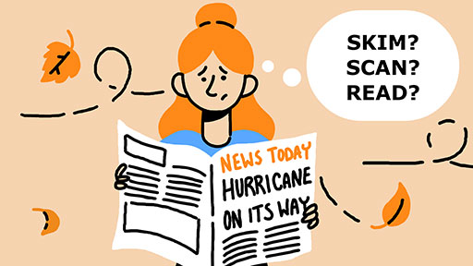
Reading Techniques sumaiya sharmin lecturer daffodil international university

Slide 2


Understanding Reading
Reading Techniques (Skimming & Scanning)
Skimming VS Scanning
Classroom Practice

Slide 3
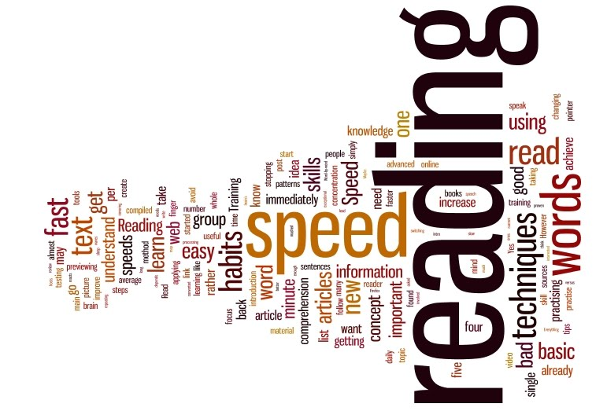
What is reading?
Reading is the process of taking in the sense or meaning of letters, symbols, etc., especially by sight or touch.

Slide 4

WHAT Are Reading Techniques?
Reading techniques are approaches to reading that you can employ to become a better and more accomplished reader.
Skimming
Scanning
Intensive Reading
Extensive Reading
Critical Reading

Slide 5

What is skimming?
To identify the main idea of a text, we run our eyes quickly over the text.
Skimming of a text is usually three or four times faster than the normal reading.
Skimming is reading rapidly in order to-
to know the general meaning of a passage
to know how the passage is organized
to get an idea of the intention of the writer.
As speed increases, comprehension
decreases.

Slide 6
Examples of Skimming
To see what is in the news on a website or on a paper.
To look through a text to decide whether you want to read it or not.
To look through the television guide/program schedule to plan your evening.
To see through a catalog to choose an offer.

Slide 7
HOW to skim?
Read the first several paragraphs:
Begin by reading the title, the headings and subheadings of the text.
Authors usually give an introduction in the first few paragraphs that helps get an overall picture of the article.
This will help you to identify the topic of the article, the subject, a little of the author’s style, author’s viewpoint, and so on.
Some expert readers read only the first and last sentence of a paragraph, while other skim the entire text.

Slide 8
Continued…
Leave out material
Once you have a general overview of the article, you should begin to leave out material right away
By the 4th or 5th paragraph you may read only the key sentences to get the main idea and skip the rest of the paragraph
Let your eyes jump ahead, picking up one or two important words, phrases or numbers

Slide 9
Continued…
Find the main ideas:
Some paragraphs may not have a main idea
Try to get the main idea of every paragraph plus a few facts
Sometimes the main idea is not in the first sentence, sometimes it is in the middle or the end of the paragraph – this may take extra time to find
The final paragraph often summarize the story or article so they may be worthwhile to read more carefully
Read Fast:
The purpose is to get the author’s main idea at a very fast speed … don’t get too caught up in details

Slide 10
Continued…
Leave out material
Once you have a general overview of the article, you should begin to leave out material right away
By the 4th or 5th paragraph you may read only the key sentences to get the main idea and skip the rest of the paragraph
Let your eyes jump ahead, picking up one or two important words, phrases or numbers

Slide 11

What is Scanning?
Reading technique that is used when you want to locate a single fact or specific bit of information without reading every word
Fast way to find information
Findings must be accurate
Often done with materials that you know something about

Slide 12
Examples of scanning
To search for a word in a dictionary or index
To find a phone number or an address in a directory
To check the time schedule of a program in an agenda
To check the price of a specific item in a catalog
To know a particular information from a text

Slide 13
How to scan?
Note the arrangement of Info:
Alphabetical
Non-alphabetical
Prose – look at title, subtitle, illustrations
Keep clue words in mind:
When you find the section most likely to contain the info, you are ready to begin scanning.
eg, telephone directory-clue word is the last name.

Slide 14
Continued…
Scan quickly:
Purpose is to locate info quickly, a high rate of speed is essential
With clue words in mind, try to scan as much of the printed matters as you can in the least amount of time
Don’t get distracted by unrelated words or info
If you find yourself beginning to read words or paragraphs, stop reading and begin to move your eyes in a scanning pattern
Read more carefully once you find the clue word

Slide 15
Continued…
Make accuracy your goal:
Accuracy is just as important as speed
Once found info you need to check that you are correct
High speed is only useful if you find the exact info you need
Goal 100% accuracy

Slide 16
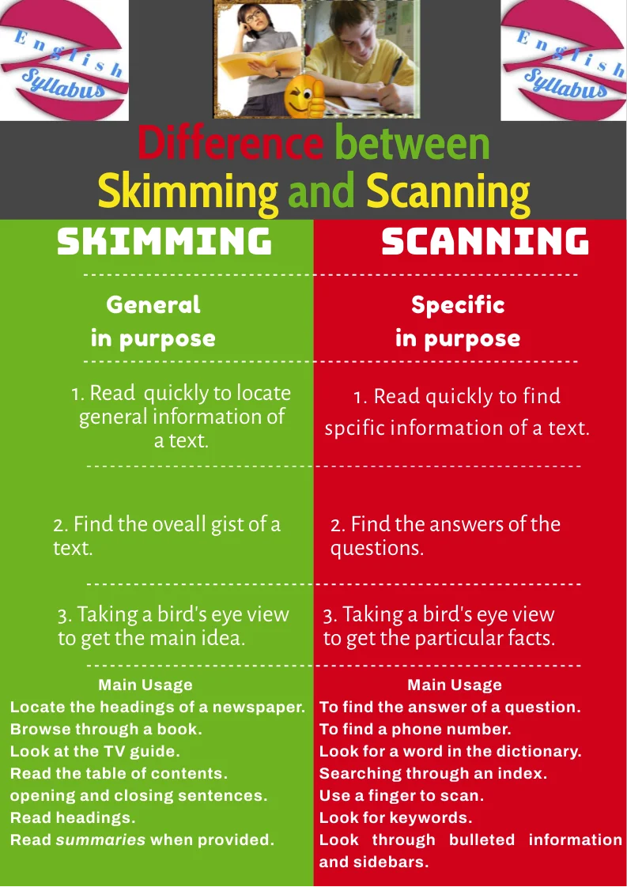
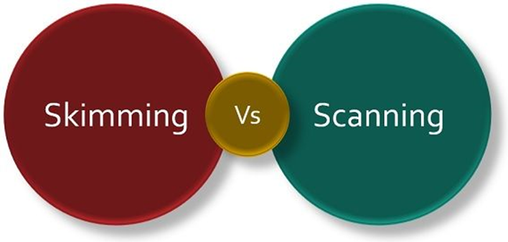
While skimming tells you what general information is within a section, scanning helps you locate a particular fact.

Slide 17
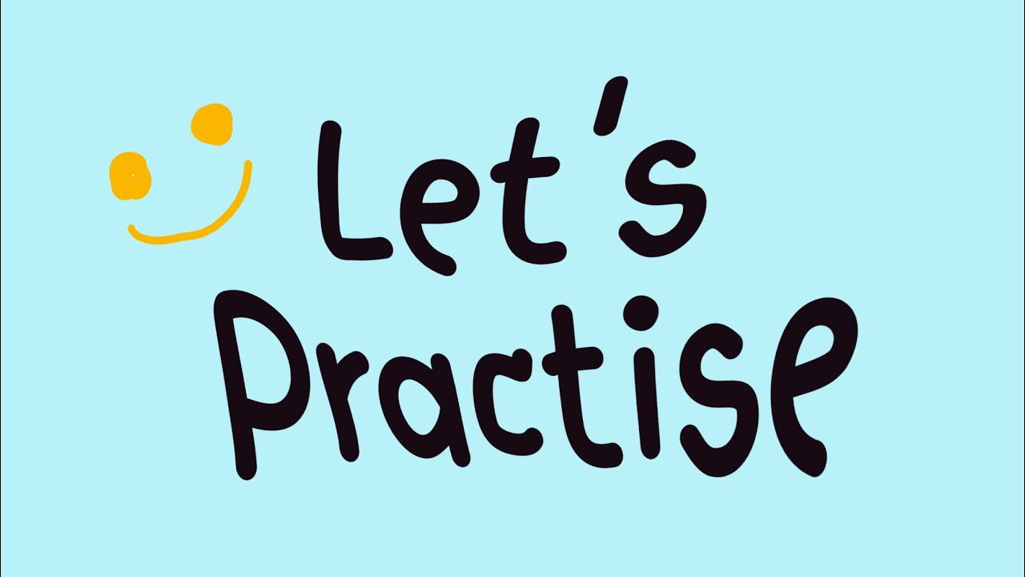

Slide 18


Slide 19

Final thought reflection

